Slide 1

CS-301 (2024-2025 Summer) Term Project
Ekin Renas Katırcı 31302 Group-22

Slide 2

Problem Description

Slide 3
Overview
The Maximum Cut problem is defined on an undirected, unweighted graph G=(V,E).
01
Goal: partition V into two disjoint subsets such that the number of edges between subsets is maximized.
02
Arises in computer science, operations research, network optimization.
03

Slide 4

Decision Problem
Question: Given G=(V,E) and integer k,
Does there exist a cut with at least k crossing edges?

Slide 5
Optimization Problem
Question: Given G=(V,E),
Find a partition of V into two subsets maximizing crossing edges.
Objective: maximize cut size.

Slide 6
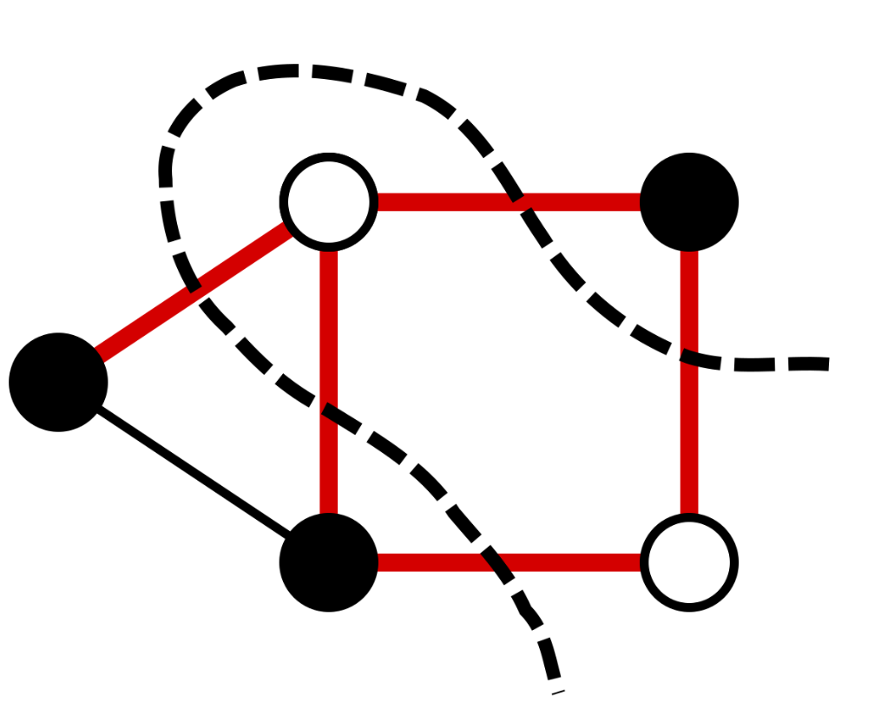
Example
Example: cycle graph with 5 vertices.
Maximum cut achieved by alternating vertices, producing 4 crossing edges.

Slide 7
Real World Applications
VLSI design (chip layout, minimize crossing connections)
Statistical physics (Ising model, spin glasses)
Network design & clustering (community detection, information flow)
Machine learning (graph-based clustering)
Finance (portfolio splits, market segmentation)

Slide 8
Hardness of the Problem
Decision version is NP-complete
Optimization version is NP-hard

Slide 9

Algorithm Description & Analysis

Slide 10

Brute-Force Algorithm
Enumerates all possible partitions of vertices into two subsets.
For each partition, compute the cut size.
Select partition with maximum cut.
Guarantees the optimal solution.

Slide 11
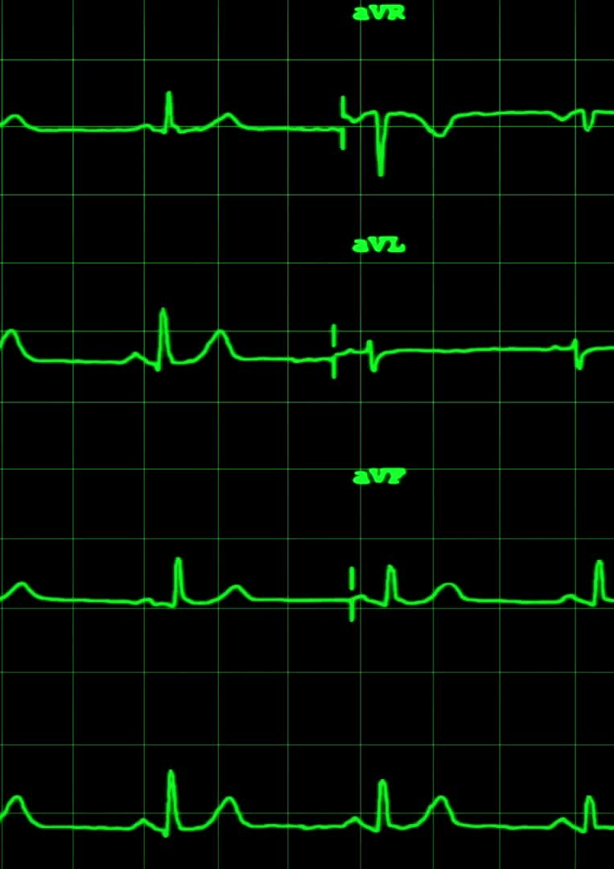
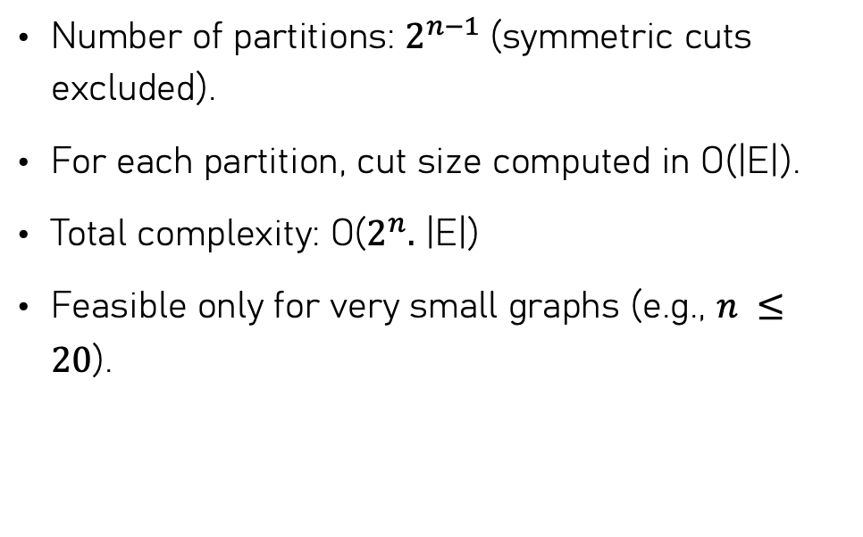
Brute-Force Time Complexity
Number of partitions: $2^{n−1}$(symmetric cuts excluded).
For each partition, cut size computed in O(|E|).
Total complexity: O($2^{n}.$ |E|)
Feasible only for very small graphs (e.g., $n ≤20$).

Slide 12

Heuristic Algorithm
Multi-start 1-flip local search approach.
Start from random cut.
Iteratively flip the vertex with maximum positive gain until no improvement possible.
Keep best result across R restarts.
Provides near-optimal solutions quickly.

Slide 13
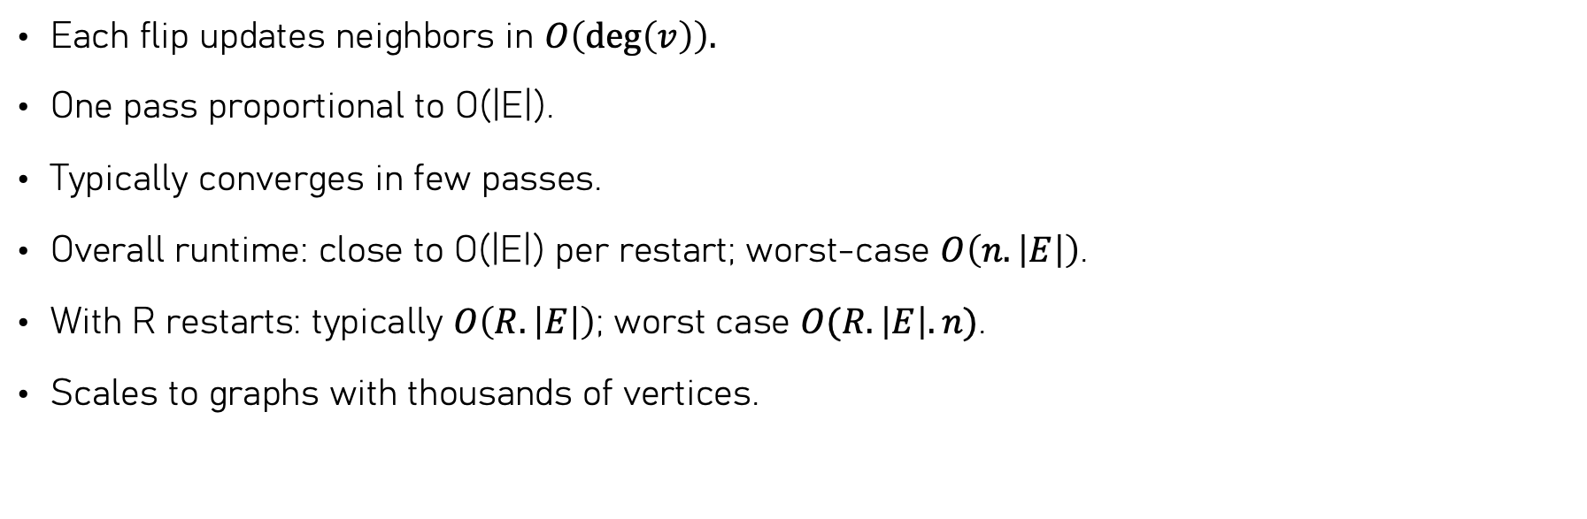
Heuristic Time Complexity
Each flip updates neighbors in $O\left(\deg\left(v\right)\right).$
One pass proportional to O(|E|).
Typically converges in few passes.
Overall runtime: close to O(|E|) per restart; worst-case $O\left(n.\left|E\right|\right)$.
With R restarts: typically $O\left(R.\left|E\right|\right)$; worst case $O(R. \left|E\right|.n)$.
Scales to graphs with thousands of vertices.

Slide 14
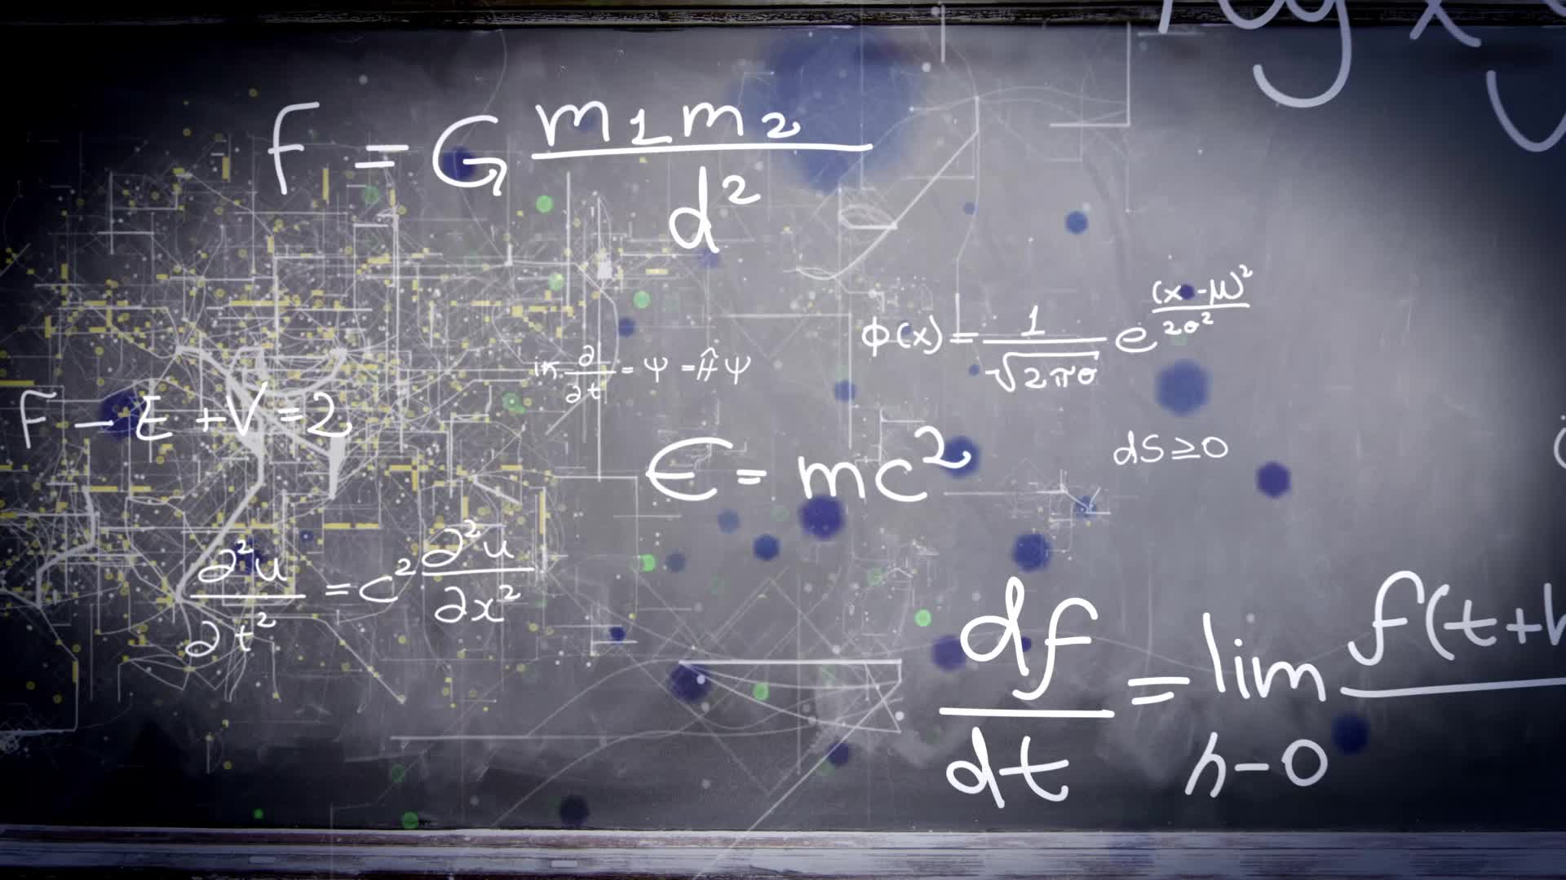
Sample Generation (Random Instance Generator)

Slide 15
Purpose
Generate random undirected, unweighted graphs for experiments.
Used to test and compare brute force and heuristic algorithms.
Ensures reproducibility with fixed random seeds.

Slide 16
Probability-Based Model
$G\left(n,p\right)$– Erdős–Rényi model
𝑮(𝒏,𝒑)– Erdős–Rényi model
Start with n vertices.
Each possible edge added independently with probability p.
Controls density of graph.
Expected edge count: $p⋅\left({n \atop 2}\right).$
Expected edge count: 𝑝⋅(𝑛¦2).
Complexity: $Θ\left(n^{2}\right).$
Complexity: Θ(𝑛^2 ).

Slide 17
Fixed-Edge Model
Start with $n$ nodes, pick exactly $m$ pairs uniformly at random.
Start with 𝑛 nodes, pick exactly 𝑚 pairs uniformly at random.
Useful when precise edge count is needed.
Uses Floyd’s selection to avoid storing all pairs.
Complexity: $Θ\left(n+m\right)time,𝒪\left(n+m\right) memory.$
Complexity: Θ(𝑛+𝑚)𝑡𝑖𝑚𝑒,𝒪(𝑛+𝑚) 𝑚𝑒𝑚𝑜𝑟𝑦.

Slide 18

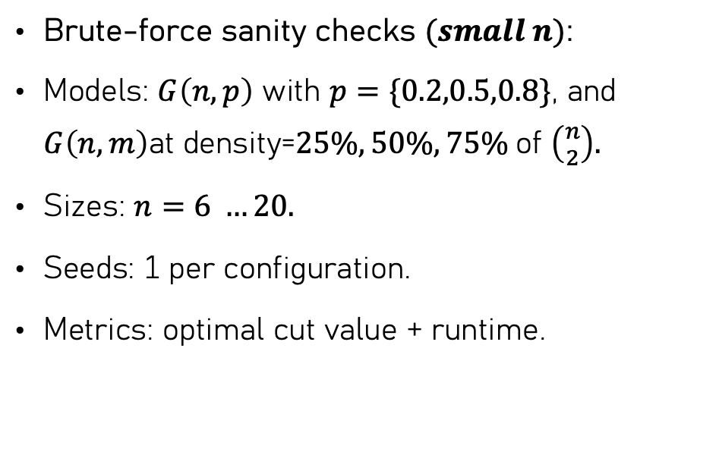
Usage In Experiments
Brute-force sanity checks $(small n)$:
Models: $G\left(n,p\right)$ with $p=\{0.2,0.5,0.8\}$, and $G\left(n,m\right)$at density=$25\%, 50\%, 75\%$of $\left({n \atop 2}\right).$
Sizes: $n=6 …20.$
Seeds: 1 per configuration.
Metrics: optimal cut value + runtime.

Slide 19
Usage In Experiment(Heuristic Initial Test)
Model: $G\left(n,p\right)$ with $p=\{0.2,0.5\}$.
Model: 𝐺(𝑛,𝑝) with 𝑝={0.2,0.5}.
Sizes: $n=(30,40,50$).
Sizes: 𝑛=(30,40,50).
Seeds: 3 per $\left(n,p\right).$
Seeds: 3 per (𝑛,𝑝).
Restarts: R=5.
Metrics: median runtime + cut size.

Slide 20
Usage In Experiments(Heuristic Performance Scaling)
Model: $G\left(n,0.5\right).$
Model: 𝐺(𝑛,0.5).
Sizes: $n=(10,20,40,50,100,200,400,800,1200,2000,3000).$
Sizes: 𝑛=(10,20,40,50,100,200,400,800,1200,2000,3000).
Trials:
$n ≤800$:$30 trials, R=5$.
𝑛 ≤800: 30 𝑡𝑟𝑖𝑎𝑙𝑠, 𝑅=5.
$n=1200,2000: 12 trials, R=2$.
𝑛=1200,2000: 12 𝑡𝑟𝑖𝑎𝑙𝑠, 𝑅=2.
$n=3000: 6 trials, R=2$.
𝑛=3000: 6 𝑡𝑟𝑖𝑎𝑙𝑠, 𝑅=2.
Metrics: mean, std, standard error, 90% confidence intervals.

Slide 21
Usage In Experiments(Heuristci Quality vs Exact)
Paired setup with brute force.
Model: $G\left(n,0.5\right)$.
Model: 𝐺(𝑛,0.5).
Sizes: $n=(10,12,14,16,18$).
Sizes: 𝑛=(10,12,14,16,18).
Instances: 6 per $n$.
Instances: 6 per 𝑛.
Restarts: $R=5$.
Restarts: 𝑅=5.
Metrics: $ρ=C_{H}/C_{BF}$, failure rate, and gap $Δ$.
Metrics: 𝜌=𝐶_𝐻 \/𝐶_𝐵𝐹, failure rate, and gap Δ.

Slide 22

Performance Testing

Slide 23
Purpose & Setup
Goal: empirically evaluate the heuristic runtime.
Compare observations with theoretical bounds.
Graphs: Erdős–Rényi $G\left(n,0.5\right).$
Graphs: Erdős–Rényi 𝐺(𝑛,0.5).
Sizes: $n=(10,20,40,50,100,200,400,800,1200,2000,3000).$
Sizes: 𝑛=(10,20,40,50,100,200,400,800,1200,2000,3000).
Multiple trials per $n$ensure statistical reliability.
Multiple trials per 𝑛 ensure statistical reliability.

Slide 24

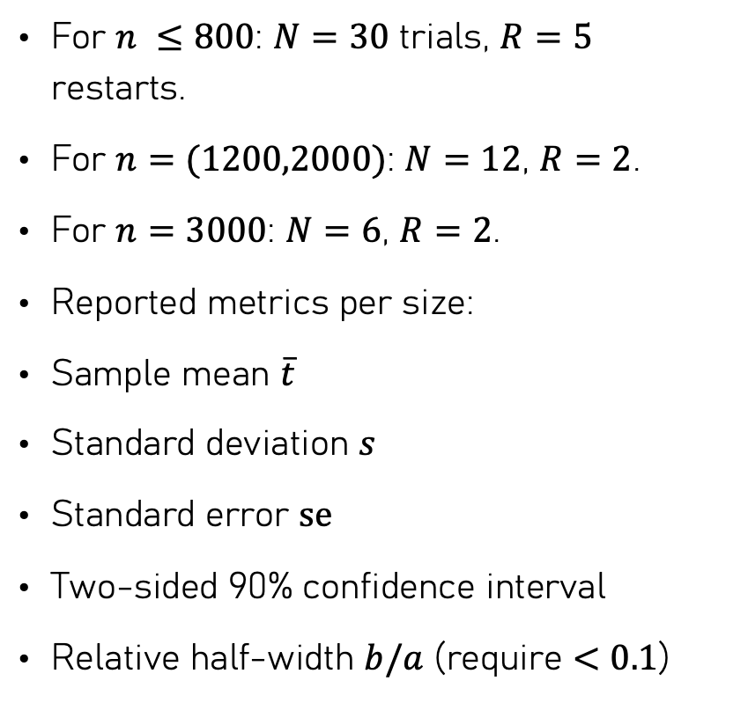
Measurment Protocol
For $n ≤800$: $N=30$ trials, $R=5$ restarts.
For $n=(1200,2000)$: $N=12$, $R=2$.
For $n=3000$: $N=6$, $R=2$.
Reported metrics per size:
Sample mean $\overline{t}$
Standard deviation $s$
Standard error $\text{se}$
Two-sided 90% confidence interval
Relative half-width $b/a$ (require $<0.1$)

Slide 25
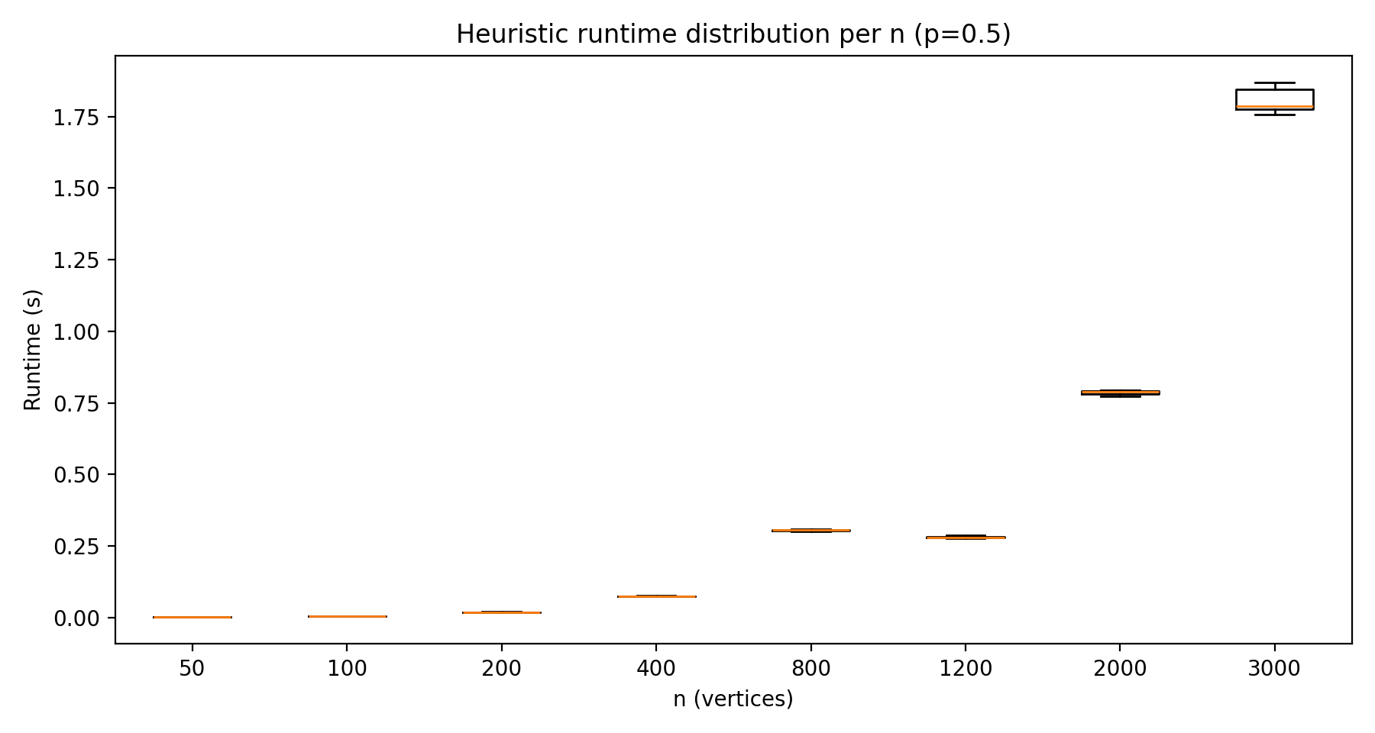
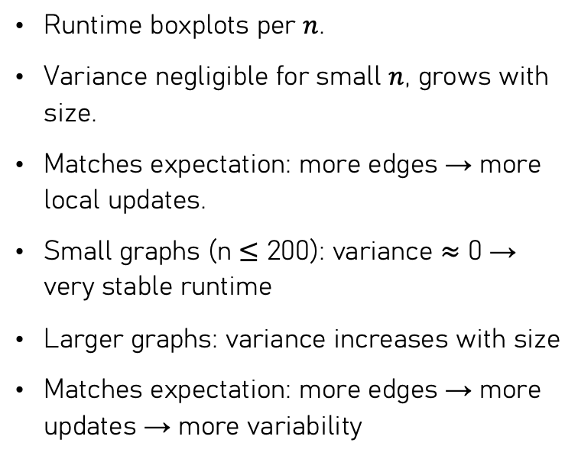
Runtime Distribution
Runtime boxplots per $n$.
Variance negligible for small $n$, grows with size.
Matches expectation: more edges → more local updates.
Small graphs (n ≤ 200): variance ≈ 0 → very stable runtime
Larger graphs: variance increases with size
Matches expectation: more edges → more updates → more variability

Slide 26
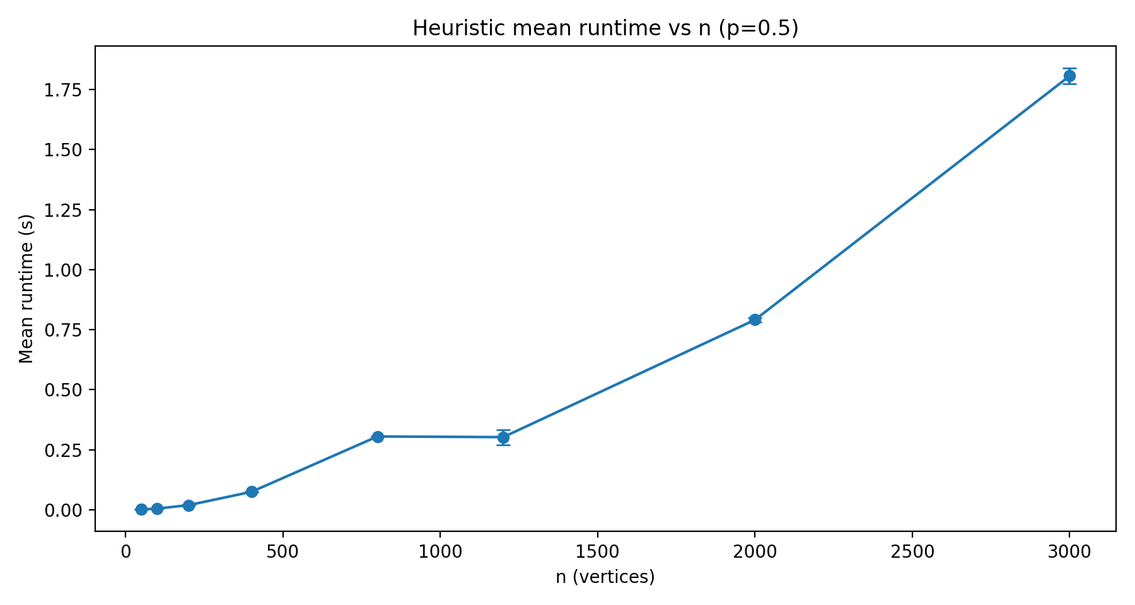
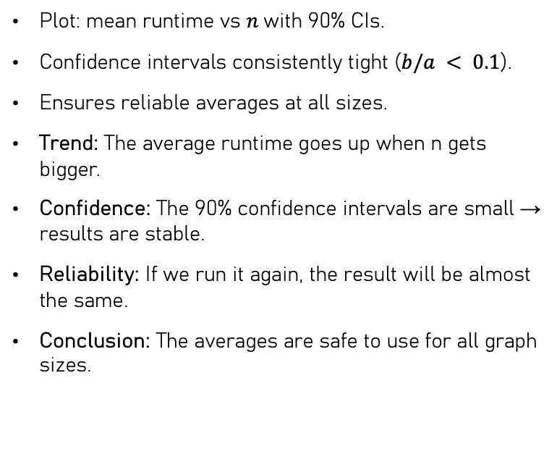
Mean Runtime & Confidence Interval
Plot: mean runtime vs $n$with 90% CIs.
Confidence intervals consistently tight ($b/a < 0.1$).
Ensures reliable averages at all sizes.
Trend: The average runtime goes up when n gets bigger.
Confidence: The 90% confidence intervals are small → results are stable.
Reliability: If we run it again, the result will be almost the same.
Conclusion: The averages are safe to use for all graph sizes.

Slide 27
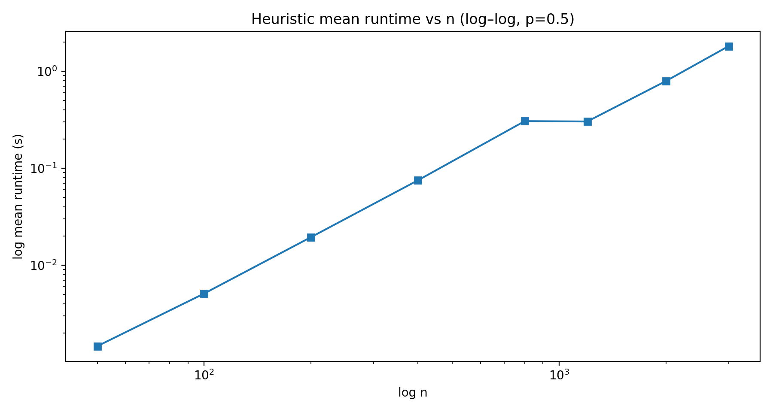
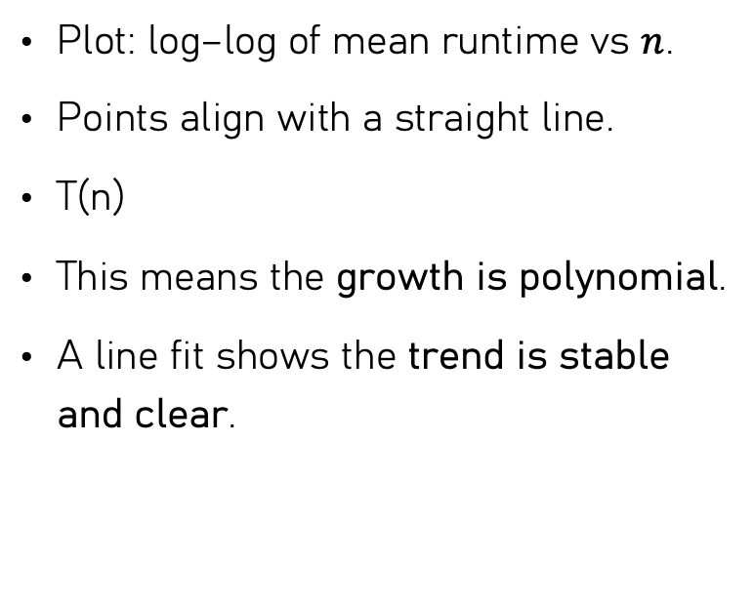
Scaling Trend & Curve Fit
Plot: log–log of mean runtime vs $n$.
Points align with a straight line.
T(n)
This means the growth is polynomial.
A line fit shows the trend is stable and clear.

Slide 28

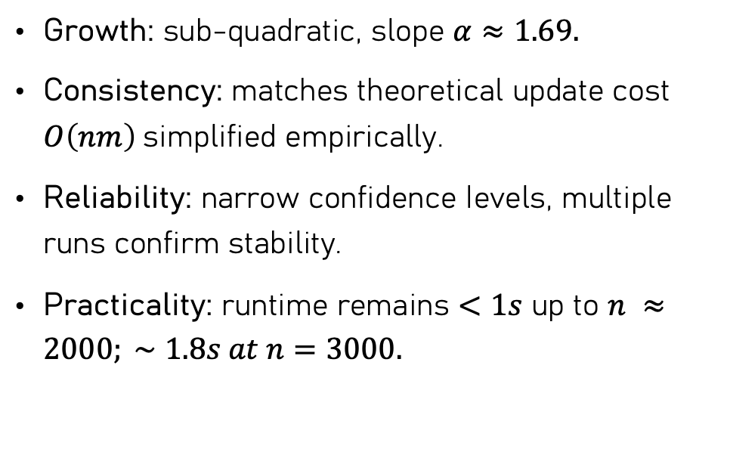
Interpretation
Growth: sub-quadratic, slope $α≈1.69.$
Consistency: matches theoretical update cost $O\left(nm\right)$simplified empirically.
Reliability: narrow confidence Ievels, multiple runs confirm stability.
Practicality: runtime remains $<1s$ up to $n ≈2000; ∼1.8s at n=3000.$

Slide 29

Quality Testing(Experimental Analysis of the Quality)

Slide 30

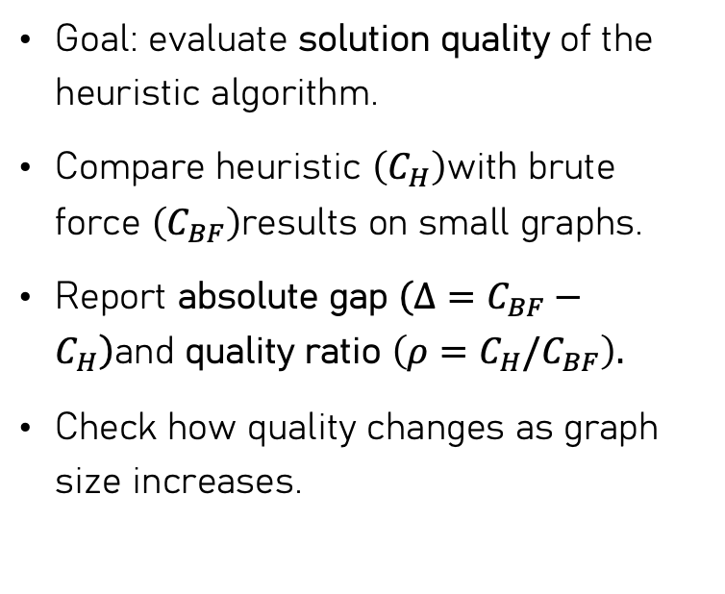
Purpose
Goal: evaluate solution quality of the heuristic algorithm.
Compare heuristic $\left(C_{H}\right)$with brute force $\left(C_{BF}\right)$results on small graphs.
Report absolute gap $\left(Δ=C_{BF}−C_{H}\right)$and quality ratio $\left(ρ=C_{H}/C_{BF}\right).$
Check how quality changes as graph size increases.

Slide 31

Experimental Setup
Graphs: Erdős–Rényi G(n,0.5).
Range: Small n, where brute force is feasible.
For each instance:
Compute optimal cut with brute force (Section 2.1).
Compare with heuristic cut (Section 2.2).
Repeat with multiple random seeds and average.

Slide 32
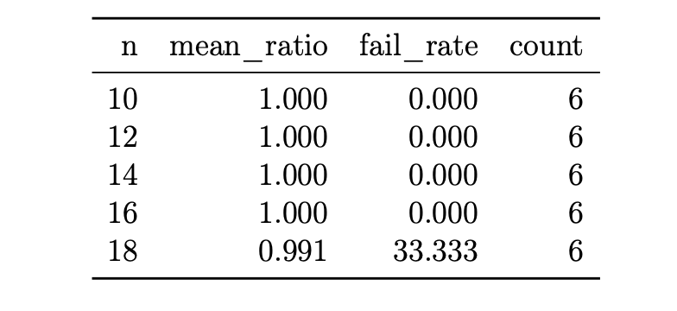
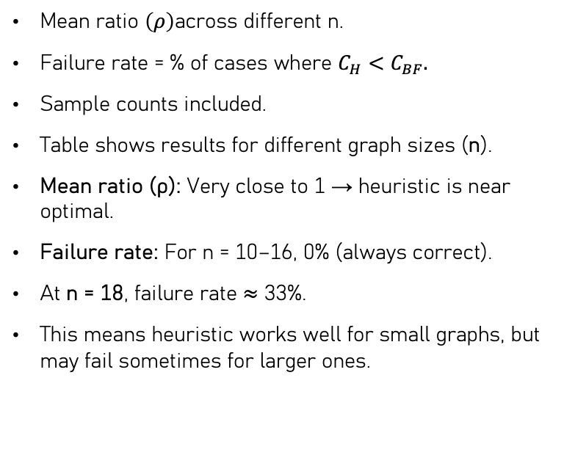
Results by n
Mean ratio $\left(ρ\right)$across different n.
Failure rate = % of cases where $C_{H}<C_{BF}.$
Sample counts included.
Table shows results for different graph sizes (n).
Mean ratio (ρ): Very close to 1 → heuristic is near optimal.
Failure rate: For n = 10–16, 0% (always correct).
At n = 18, failure rate ≈ 33%.
This means heuristic works well for small graphs, but may fail sometimes for larger ones.

Slide 33
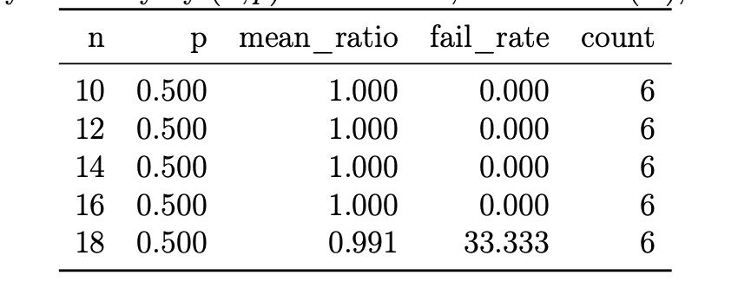
Results by(n,p)
Quality summarized across both size and density.
Same metrics: ratio, failure rate, sample count.
This table shows results for different graph sizes (n) and densities (p).
The mean ratio (ρ) is close to 1 in almost all cases → heuristic is near the best cut.
Failure rate is 0% for most cases, but goes up to about 33% at n=18.
This means the heuristic works very well for small graphs, but bigger graphs are harder.
Sample count shows how many graphs were tested for each case.

Slide 34
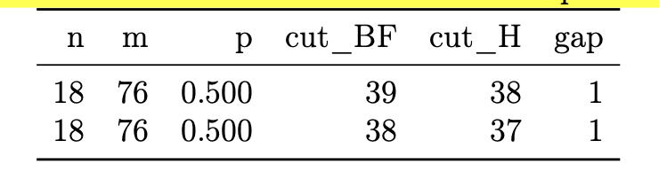
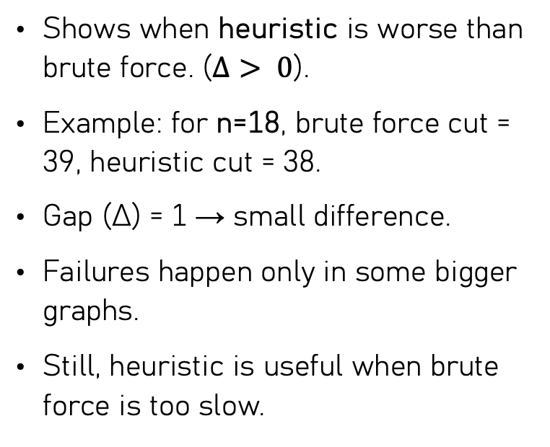
Failure Cases
Shows when heuristic is worse than brute force. ($Δ> 0$).
Example: for n=18, brute force cut = 39, heuristic cut = 38.
Gap (Δ) = 1 → small difference.
Failures happen only in some bigger graphs.
Still, heuristic is useful when brute force is too slow.

Slide 35
Interpretation
Ratios are typically close to 1 → heuristic near-optimal.
Failure rate = 0% for small n.
At n=18: failure rate ≈ 33%.
Degradation due to complex search landscape.
Still practical when brute force becomes infeasible.

Slide 36

Thank you for Listening

